Slide 1
ENGINEERING RELIABLE AGENTIC AI SYSTEMS
The Loop Is
the Product
Reliable agents need explicit scope, independent verification, durable state, and bounded exits.
Rick Hightower · Spillwave Solutions · 28 August 2026
Notes:
Presenter notes
Open with the central claim. The model is one component inside a controlled system.
[Sources]
- COMPLETE-HANDOUT.pdf, Engineering Reliable Agentic AI Systems workshop packet.
- https://github.com/RichardHightower/reliable-agentic-lab
[/Sources]

Slide 2
THE OPERATING PROBLEM
Prompting fails under volume because the human remains the quality system.
Repeated work needs a runtime that can measure, remember, stop, and explain. The person should define the contract once, not judge every turn by hand.
SPILLWAVE RESEARCH
02
Notes:
Presenter notes
Repeated work needs a runtime that can measure, remember, stop, and explain. The person should define the contract once, not judge every turn by hand.
[Sources]
- COMPLETE-HANDOUT.pdf, Engineering Reliable Agentic AI Systems workshop packet.
- https://github.com/RichardHightower/reliable-agentic-lab
[/Sources]

Slide 3
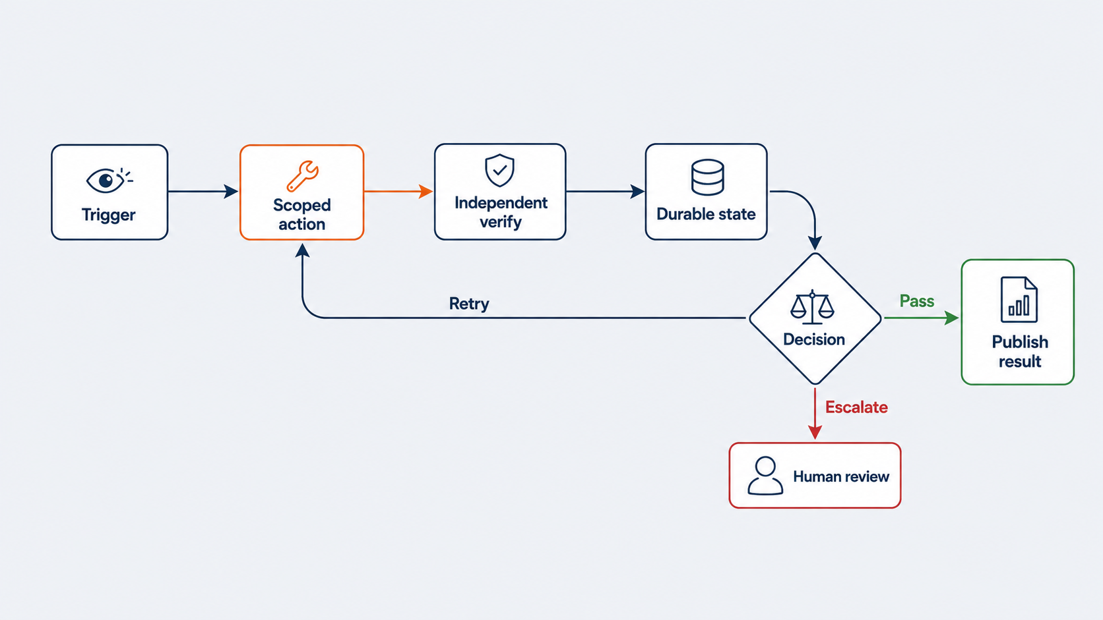
FIGURE 1
A reliable loop controls what happens around ReAct.
Yao et al. ReAct. arXiv:2210.03629.
SPILLWAVE RESEARCH
03
Notes:
Presenter notes
Use the visual as the primary explanation. A reliable loop controls what happens around ReAct.
Yao et al. ReAct. arXiv:2210.03629.
[Sources]
- COMPLETE-HANDOUT.pdf, Engineering Reliable Agentic AI Systems workshop packet.
- https://github.com/RichardHightower/reliable-agentic-lab
[/Sources]

Slide 4
THE FIVE CONTROL SURFACES
The model acts. The runtime owns the decision.
Trigger defines when work starts. Scope limits action. Verification scores evidence. State survives the chat. Exit policy selects pass, retry, or escalation.
SPILLWAVE RESEARCH
04
Notes:
Presenter notes
Trigger defines when work starts. Scope limits action. Verification scores evidence. State survives the chat. Exit policy selects pass, retry, or escalation.
[Sources]
- COMPLETE-HANDOUT.pdf, Engineering Reliable Agentic AI Systems workshop packet.
- https://github.com/RichardHightower/reliable-agentic-lab
[/Sources]

Slide 5
FLOW CHANGES OUTCOMES
Same model. Different flow.
The test-driven flow generated, executed, and repaired. The result is evidence for flow design, not a universal benchmark guarantee.
19
44
→
pass@5
Ridnik, Kredo, Friedman. AlphaCodium. arXiv:2401.08500.
SPILLWAVE RESEARCH
05
Notes:
Presenter notes
The lesson is that a test-driven flow changed performance without changing the model weights. Do not generalize the number beyond the evaluated dataset.
[Sources]
- Ridnik, Kredo, Friedman. AlphaCodium. arXiv:2401.08500.
- COMPLETE-HANDOUT.pdf.
[/Sources]

Slide 6
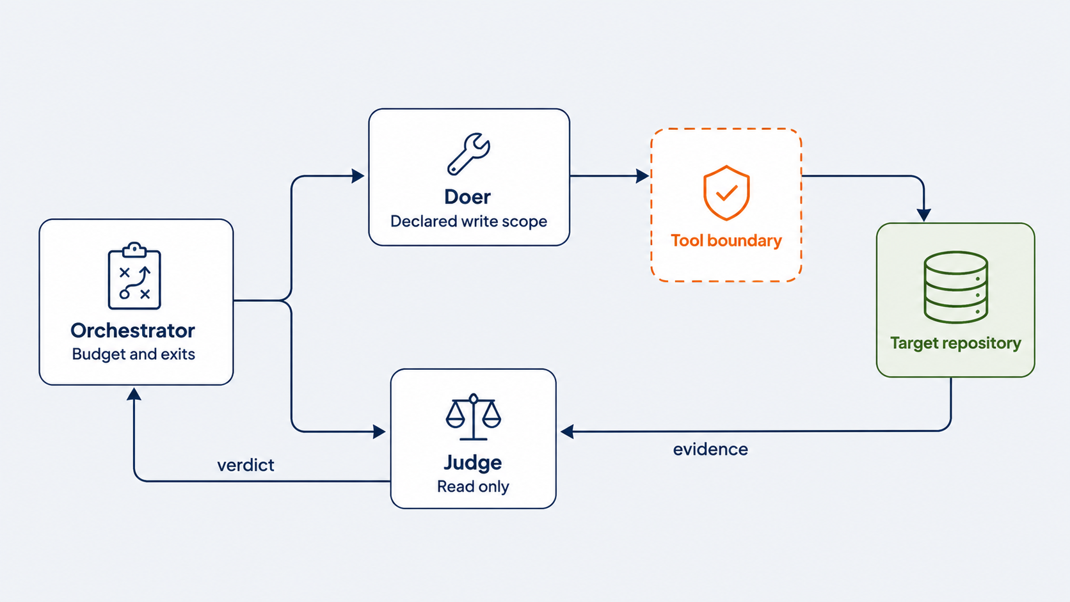
FIGURE 2
Write scope separates action from judgment.
SPILLWAVE RESEARCH
06
Notes:
Presenter notes
Use the visual as the primary explanation. Write scope separates action from judgment.
[Sources]
- COMPLETE-HANDOUT.pdf, Engineering Reliable Agentic AI Systems workshop packet.
- https://github.com/RichardHightower/reliable-agentic-lab
[/Sources]

Slide 7
INDEPENDENT VERIFICATION
The judge cannot grade its own homework when it has no write path.
The doer can change only declared paths. The judge reads evidence and returns a verdict. Deny rules take precedence over allow rules.
SPILLWAVE RESEARCH
07
Notes:
Presenter notes
The doer can change only declared paths. The judge reads evidence and returns a verdict. Deny rules take precedence over allow rules.
[Sources]
- COMPLETE-HANDOUT.pdf, Engineering Reliable Agentic AI Systems workshop packet.
- https://github.com/RichardHightower/reliable-agentic-lab
[/Sources]

Slide 8
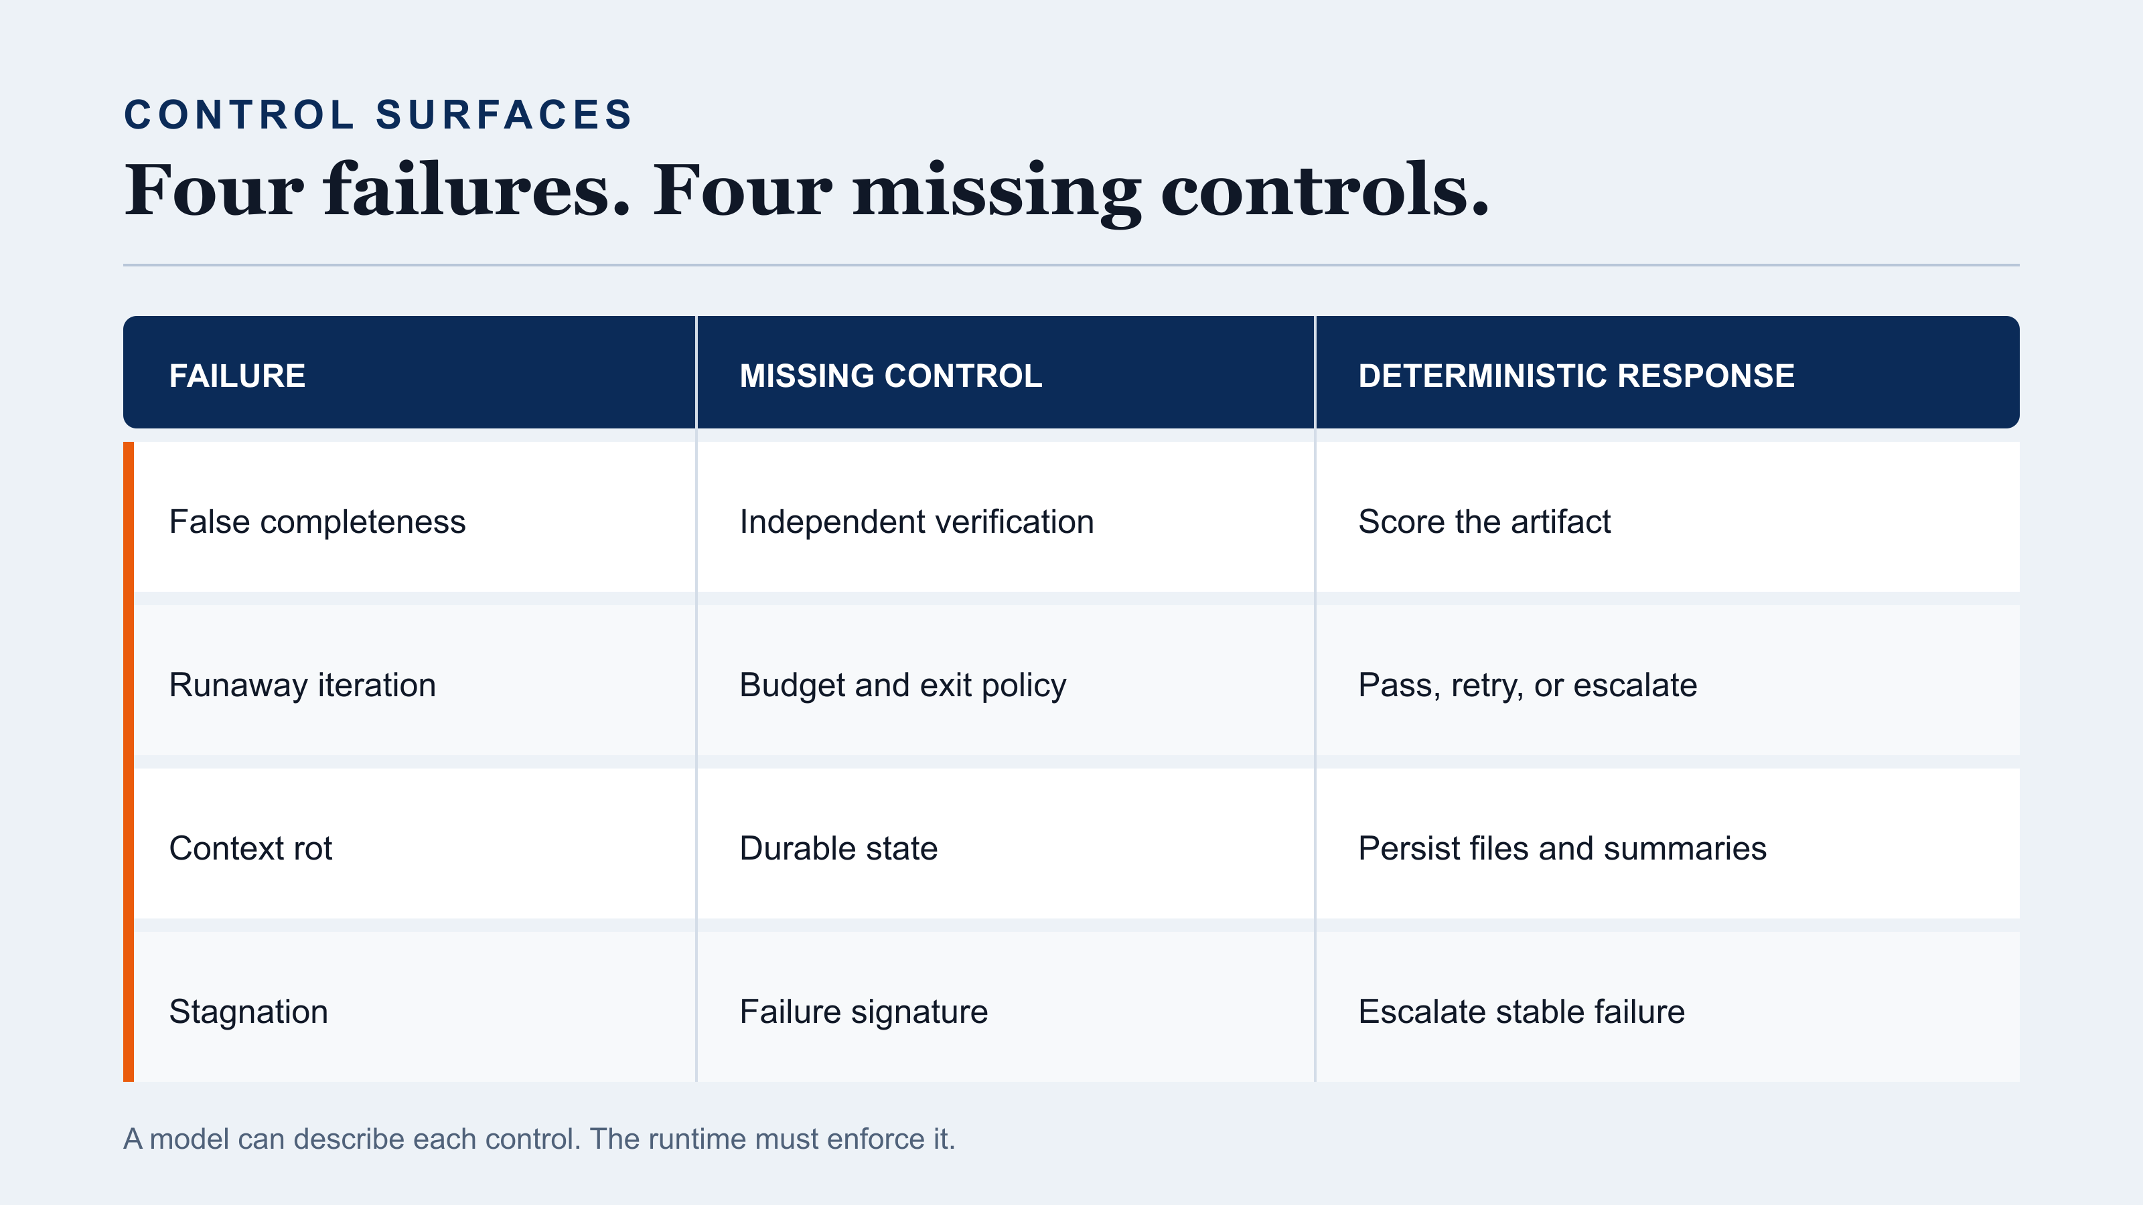
TABLE 1
Every common loop failure points to a missing control.
SPILLWAVE RESEARCH
08
Notes:
Presenter notes
Use the visual as the primary explanation. Every common loop failure points to a missing control.
[Sources]
- COMPLETE-HANDOUT.pdf, Engineering Reliable Agentic AI Systems workshop packet.
- https://github.com/RichardHightower/reliable-agentic-lab
[/Sources]

Slide 9
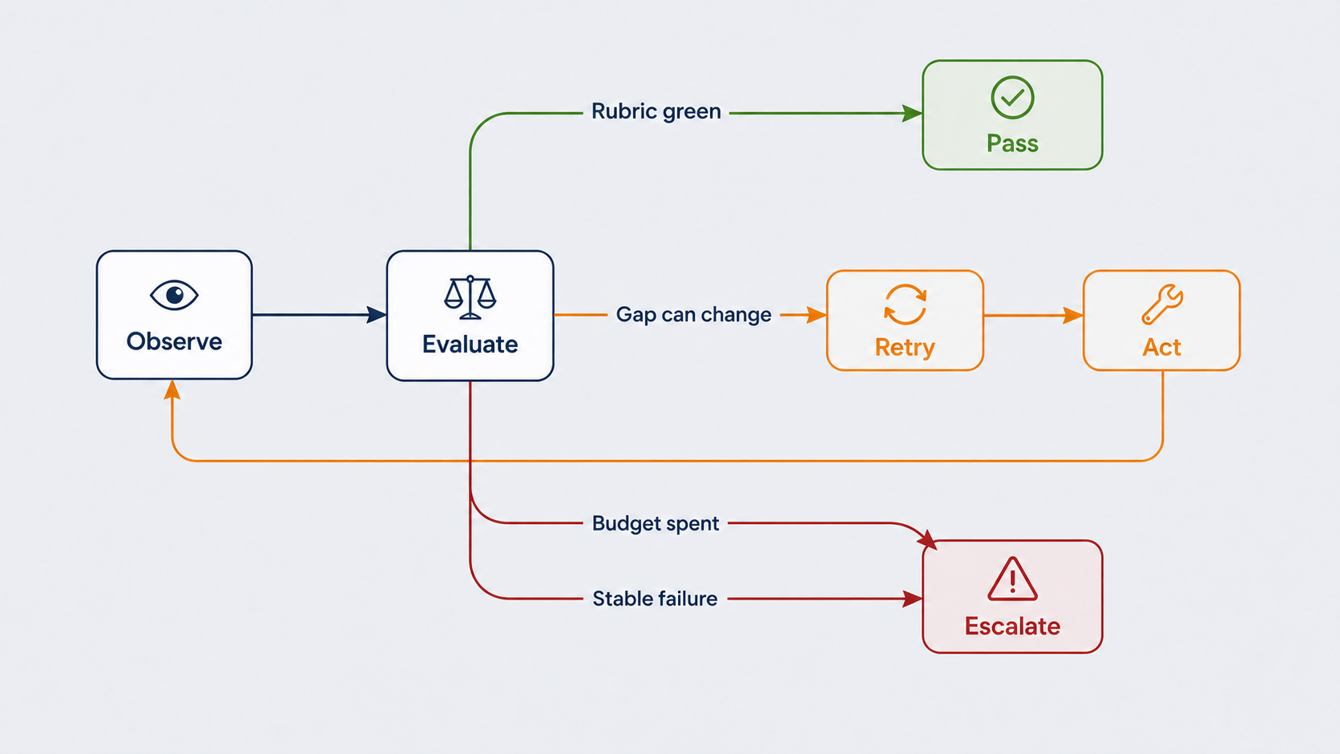
FIGURE 3
There are three exits, and no fourth.
SPILLWAVE RESEARCH
09
Notes:
Presenter notes
Use the visual as the primary explanation. There are three exits, and no fourth.
[Sources]
- COMPLETE-HANDOUT.pdf, Engineering Reliable Agentic AI Systems workshop packet.
- https://github.com/RichardHightower/reliable-agentic-lab
[/Sources]

Slide 10
THE EXIT PEOPLE FORGET
Stable failure is evidence that the loop is not converging.
If the same rubric rows fail twice, another identical retry buys cost instead of progress. Compare normalized failure signatures and escalate when the signature repeats.
SPILLWAVE RESEARCH
10
Notes:
Presenter notes
If the same rubric rows fail twice, another identical retry buys cost instead of progress. Compare normalized failure signatures and escalate when the signature repeats.
[Sources]
- COMPLETE-HANDOUT.pdf, Engineering Reliable Agentic AI Systems workshop packet.
- https://github.com/RichardHightower/reliable-agentic-lab
[/Sources]

Slide 11
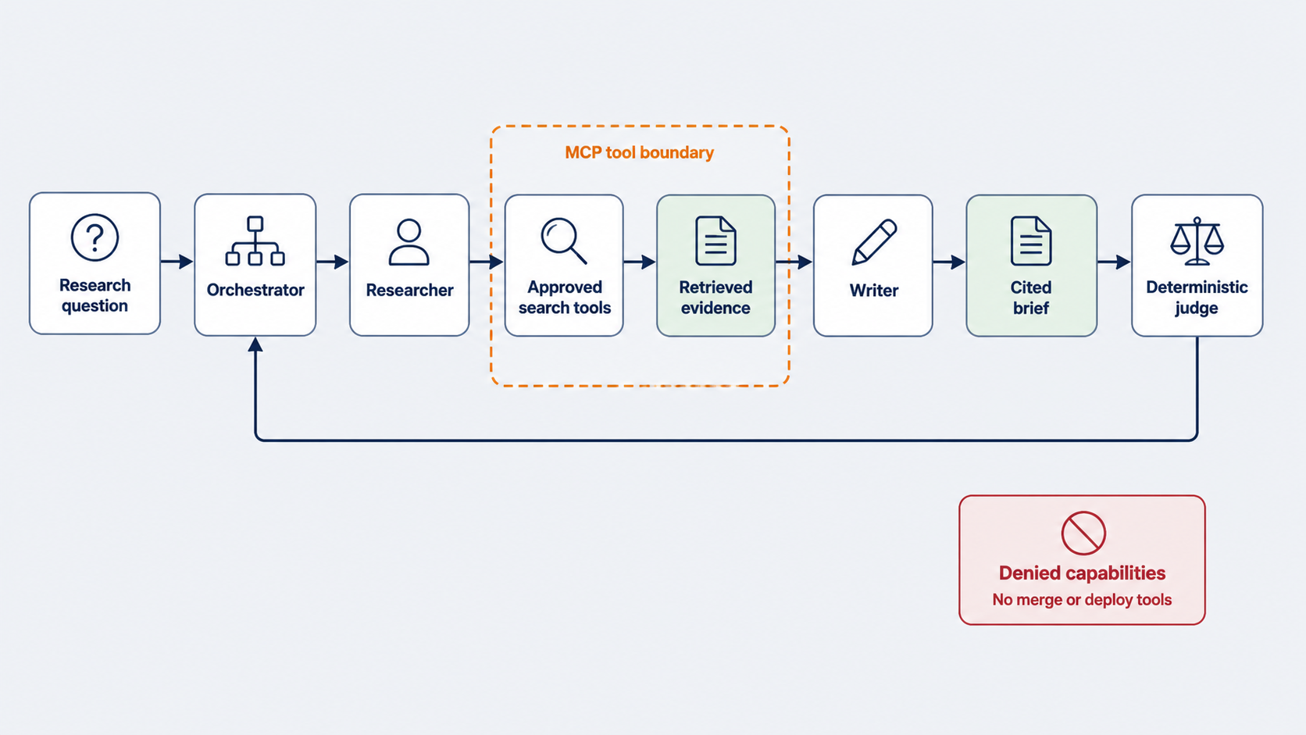
FIGURE 4
A research loop needs a narrow MCP tool boundary.
SPILLWAVE RESEARCH
11
Notes:
Presenter notes
Use the visual as the primary explanation. A research loop needs a narrow MCP tool boundary.
[Sources]
- COMPLETE-HANDOUT.pdf, Engineering Reliable Agentic AI Systems workshop packet.
- https://github.com/RichardHightower/reliable-agentic-lab
[/Sources]

Slide 12
MODEL CONTEXT PROTOCOL
Tool reach is a capability decision, not a convenience setting.
The research loop can retrieve evidence and write inside its work directory. It cannot merge code, deploy software, or cross an undeclared boundary.
SPILLWAVE RESEARCH
12
Notes:
Presenter notes
The research loop can retrieve evidence and write inside its work directory. It cannot merge code, deploy software, or cross an undeclared boundary.
[Sources]
- COMPLETE-HANDOUT.pdf, Engineering Reliable Agentic AI Systems workshop packet.
- https://github.com/RichardHightower/reliable-agentic-lab
[/Sources]

Slide 13
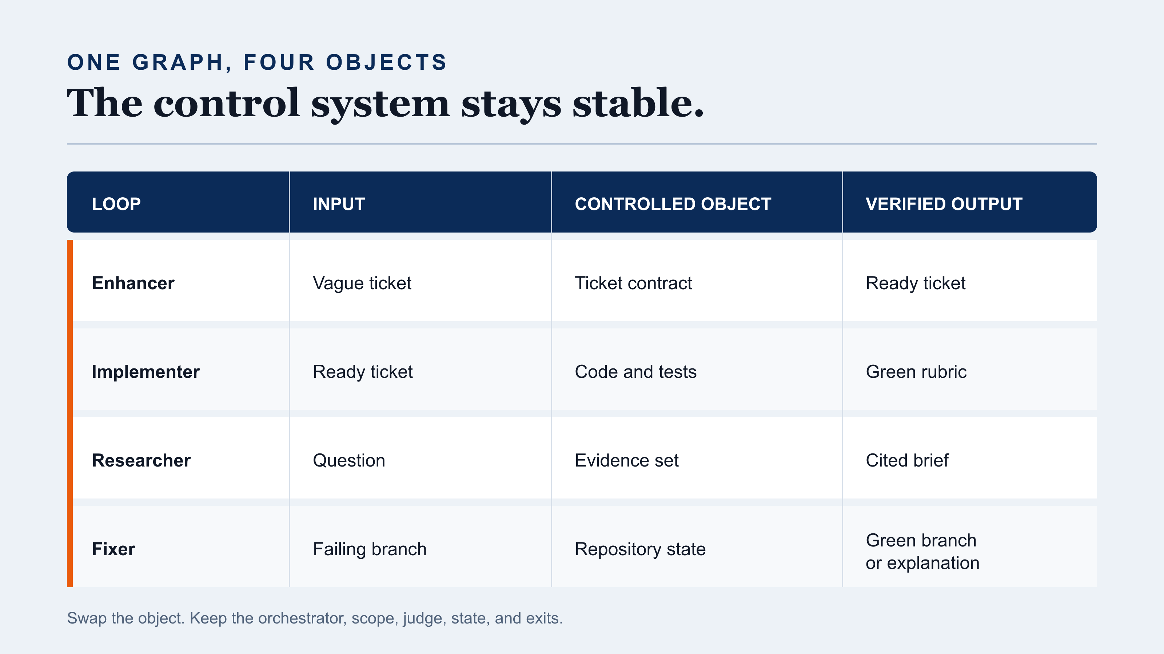
TABLE 2
Swap the controlled object. Keep the graph.
SPILLWAVE RESEARCH
13
Notes:
Presenter notes
Use the visual as the primary explanation. Swap the controlled object. Keep the graph.
[Sources]
- COMPLETE-HANDOUT.pdf, Engineering Reliable Agentic AI Systems workshop packet.
- https://github.com/RichardHightower/reliable-agentic-lab
[/Sources]

Slide 14
PRODUCTION ARCHITECTURE
When nobody watches, evidence becomes part of correctness.
STATE
Attempt, failure signature, cost, and last verified result.
RECEIPT
A tree hash and write time bind the claim to repository state.
OBSERVABILITY
A trace file survives when a terminal pane disappears.
AGREEMENT
Local and remote gates must evaluate the same revision.
SPILLWAVE RESEARCH
14
Notes:
Presenter notes
Unattended execution changes the trigger, but it also makes state, receipts, and traces mandatory.
[Sources]
- COMPLETE-HANDOUT.pdf, Engineering Reliable Agentic AI Systems workshop packet.
- https://github.com/RichardHightower/reliable-agentic-lab
[/Sources]

Slide 15
ADOPTION ORDER
Start with the gate, then add autonomy.
Define a testable contract. Enforce write scope. Add an independent judge. Put budgets in code. Persist state. Add unattended triggers only after local and remote gates agree.
SPILLWAVE RESEARCH
15
Notes:
Presenter notes
Define a testable contract. Enforce write scope. Add an independent judge. Put budgets in code. Persist state. Add unattended triggers only after local and remote gates agree.
[Sources]
- COMPLETE-HANDOUT.pdf, Engineering Reliable Agentic AI Systems workshop packet.
- https://github.com/RichardHightower/reliable-agentic-lab
[/Sources]

Slide 16
LIMITATIONS
A harness reduces failure. It does not remove uncertainty.
Tests can measure the wrong thing. Model judges still guess. Receipts can become stale. External tools can return hostile content. Each boundary must be enforced and observed.
SPILLWAVE RESEARCH
16
Notes:
Presenter notes
Tests can measure the wrong thing. Model judges still guess. Receipts can become stale. External tools can return hostile content. Each boundary must be enforced and observed.
[Sources]
- COMPLETE-HANDOUT.pdf, Engineering Reliable Agentic AI Systems workshop packet.
- https://github.com/RichardHightower/reliable-agentic-lab
[/Sources]

Slide 17
TERMINOLOGY
Five terms to keep consistent
Loop Engineering
Outer control around the Reason and Act cycle.
Harness Engineering
Validation and containment around model action.
Graph Engineering
Intent expressed as checkable steps and relationships.
Failure signature
Normalized set of failed checks for one attempt.
Receipt
Evidence bound to a specific repository state and time.
SPILLWAVE RESEARCH
17
Notes:
Presenter notes
Use these terms consistently across architecture, code review, and operating procedures.
[Sources]
- COMPLETE-HANDOUT.pdf, Engineering Reliable Agentic AI Systems workshop packet.
- https://github.com/RichardHightower/reliable-agentic-lab
[/Sources]

Slide 18
CONCLUSION
The loop is the product. The prompt is not.
Define the contract once. Let the system act within scope, verify evidence, remember state, and stop with a reason.
SPILLWAVE RESEARCH
18
Notes:
Presenter notes
Define the contract once. Let the system act within scope, verify evidence, remember state, and stop with a reason.
[Sources]
- COMPLETE-HANDOUT.pdf, Engineering Reliable Agentic AI Systems workshop packet.
- https://github.com/RichardHightower/reliable-agentic-lab
[/Sources]

